Slide 1
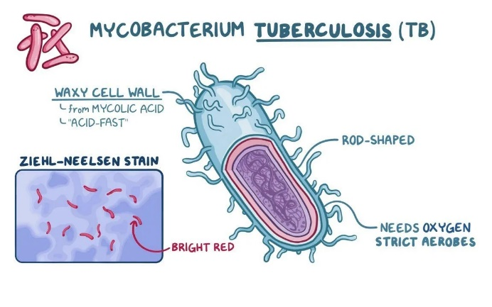
Tuberculosis
Know the symptoms!

Slide 2
About 89000 people die of Tuberculosis per year in South Africa
WHERE TO FIND HELP:
SYMPTOMS:
Fever
Fatigue
Weight loss
Persistent cough
Blood in cough
Night sweats
Visit your nearest clinic in your area to get tested for TB so that you can start treatment as early as possible.

